Slide 1
The Agile : Scrum Framework at glance
by RASHED ZAHAN RUMON

Slide 2
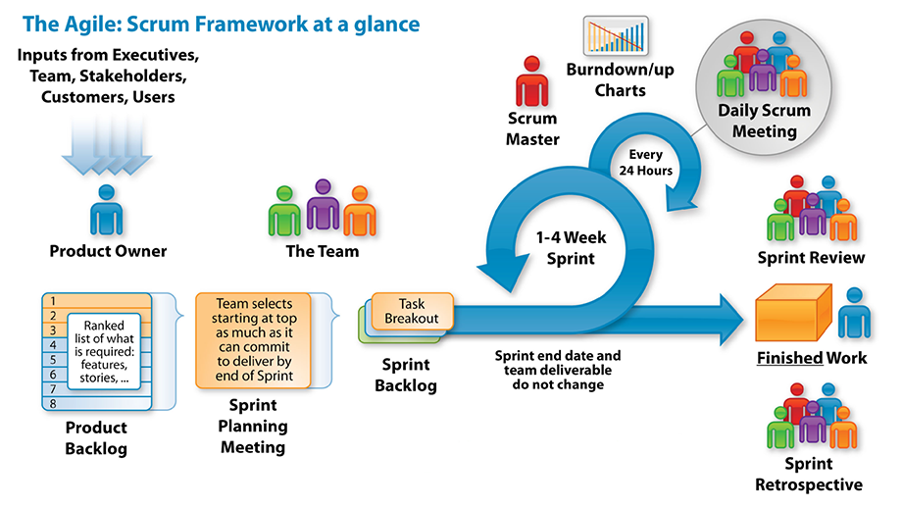

Slide 3
Artifacts:
Term | Definition
User Stories | Something a user wants and associated acceptance criteria. For example, «As a Facebook user, I need an ability to retrieve a link to someone’s else entry so that I can share it via other social networks or send by mail to my friends»
Epics | A collection of User Stories
Backlog | A list of requirements for a Product or Sprint

Slide 4
Meetings:
Term | Definition
Sprints (Iterations) | Time-boxed effort to create a «Done» product Increment
Sprint Planning | Time-boxed effort to plan the Sprint by the Scrum team
Grooming | «Quick» sprint pre-planning , where the whole team required
Daily Stand-ups | Time-boxed effort to share the status, usually takes 10 minutes
Sprint Retrospective | Time-boxed review of the Scrum Team’s performance during the last Sprint in order to improve in the next Sprint

Slide 5
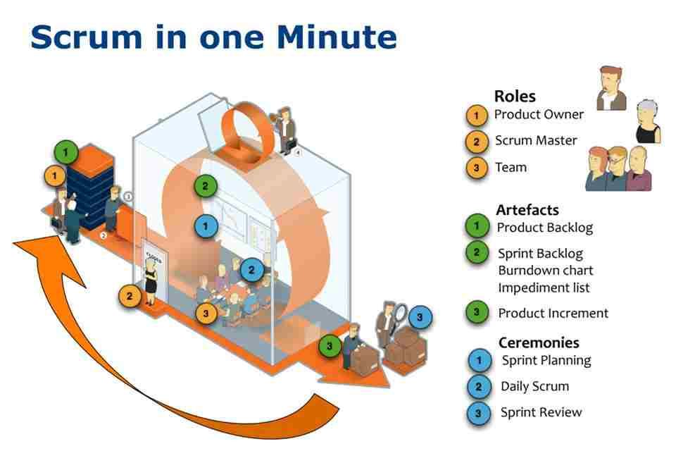

Slide 6
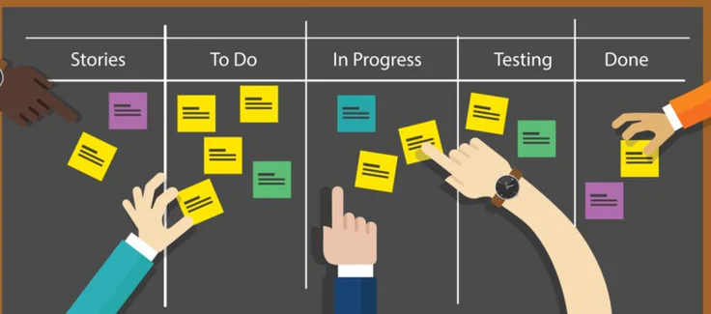
Scrum Board :

Slide 7
Definition of Ready (DoR) & Definition of Done (DoD)
Definition of Ready (DoR) | Definition of Done (DoD)
User Story is clear User Story is testable User Story is feasible User Story defined User Story Acceptance Criteria defined User Story dependencies identified User Story sized by Development Team Scrum Team accepts User Experience artefacts Performance criteria identified, where appropriate Scalability criteria identified, where appropriate Security criteria identified, where appropriate Person who will accept the User Story is identified Team has a good idea what it will mean to Demo the User Story | Code produced (all ‘to do’ items in code completed) Code commented, checked in and run against current version in source control Peer reviewed (or produced with pair programming) and meeting development standards Builds without errors Unit tests written and passing Deployed to system test environment and passed system tests Passed UAT (User Acceptance Testing) and signed off as meeting requirements Any build / deployment / configuration changes are implemented / documented / communicated Relevant documentation / diagrams produced and / or updated Remaining hours for task set to zero and task closed

